Slide 1
An Integrated Test Environment for Systems Engineering
Ryan Brooks
Roberto Escobar
Boeing
Mesa, AZ

Slide 2
What is OSEE’s OTE Framework?
The Open System Engineering Test Environment (OTE) is a framework for requirements-based testing in the context of an overall systems engineering approach
OTE has been used commercially to qualify mission software for Boeing’s next generation Apache Attack Helicopter
Being contributed as a component of the Open System Engineering Environment (OSEE) Eclipse project
Facilitates seamless flow between test development, debugging, execution, and result analysis

Slide 3
Integrated Requirements-Based Testing
Bidirectional traceability between software requirements, application code, and tests is provided through OSEE Application Framework
Coverage holes detection via traceability
Action Tracking System identifies test impacts driven by requirement changes
Test development status tracking
Detailed, integrated test status and coverage reporting
Notes:
So why is this part of OSEE?

Slide 4
Architecture
Dynamic Service Discovery
OSEE Datastore
Remote File
System
Relational Database
JINI Lookup
OSEE Application Server
Models
Test Run Manager
OSEE Test Server
Test Manager
Message Watch
Mux View
Model GUI
Service Manager
Define (Requirements)
ATS (Change Management)
OSEE Test Client
Test Environment Service
RMI
I/O Service
Serial
Ethernet
Flight Box
1553 Mux Bus
GPS
Radio 1
Radar
Sensors
…
Unit under test containing embedded flight code

Slide 5
Test Environment Service
Provides dynamic lookup of resources
Provides both soft real-time and simulated capabilities
Schedules periodic execution of models (simulation components)
  API for easy creation of simulated components
Supports a user configurable number of simultaneous client connections
Manages I/O and testing resources

Slide 6
Extensible Real-time Messaging System
Supports communication with real hardware via
  MIL-STD-1553 MUX
  Serial
  Wire
  Analog and Digital discretes
  Publish/Subscribe Data Distribution Service (DDS) through Ethernet

Slide 7
Real-time & Simulated Functional Testing
Simulated Environment (eases demand on limited test station hardware resources)
Tests (without modification of any kind) can be run in both soft real-time and simulated environments (simultaneously, if desired)
Simulated components can be used with both environments
Streaming automated test point tally and rollup of pass/fail determination
Interactive Testing (automated tests with user input)

Slide 8
Test Manager
Provides a common interface for functional tests in real-time and simulated environments across all levels of testing fidelity
Test results streamed in real-time from test service to test manager
Create, save, and load run lists
Integrated with JDT/CDT debugger
Lists available test services that can be used to run test files
Real-time display of test service usage information
Supports the execution of multiple simultaneous batches within a single workspace
Notes:
Leverages Java Development Toolkit (JDT) and C/C++ Development Toolkit (CDT)

Slide 9
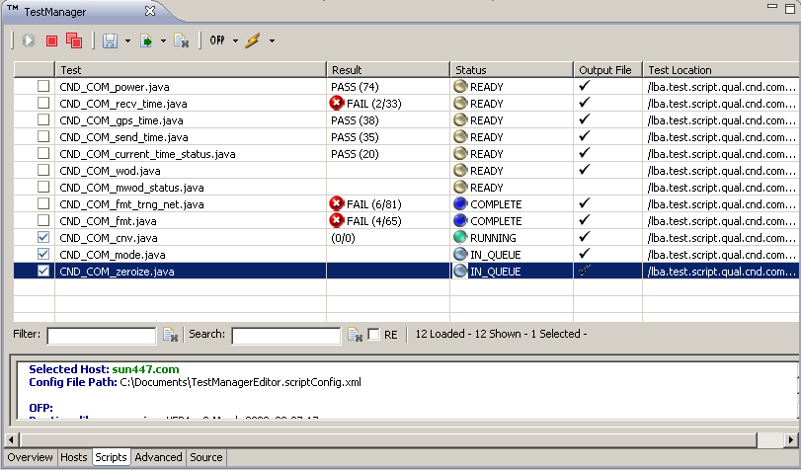
Test Manager

Slide 10
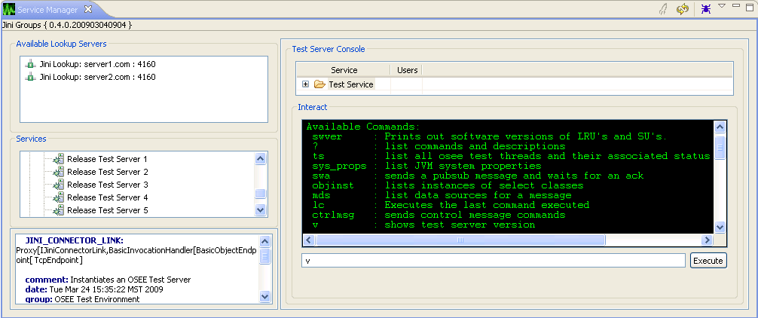
Service Manager
Integrated test server resource management
Remote viewing and manipulation of test service

Slide 11
Test Output
Test output file format is XML
Interactive out files (user can navigate the out file)
User selectable views of out files
Automatic correlation of a run-time test point to the test source line that generated it (integrated into JDT using problem view and markers)
Full test output can be stored in the OSEE object-oriented persistence layer for later analysis and results summary and reporting

Slide 12
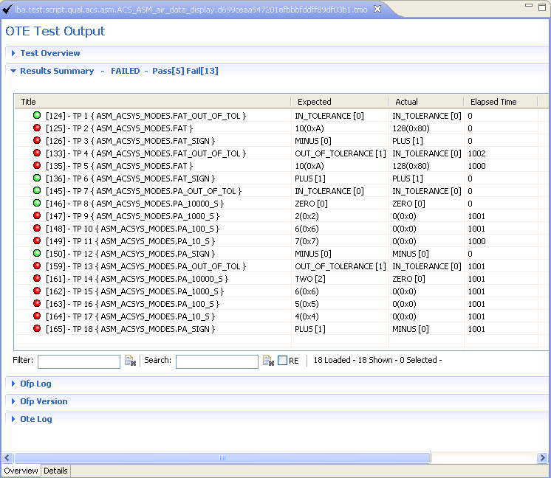
Test Output Editor
Test points linked to test code that generated

Slide 13
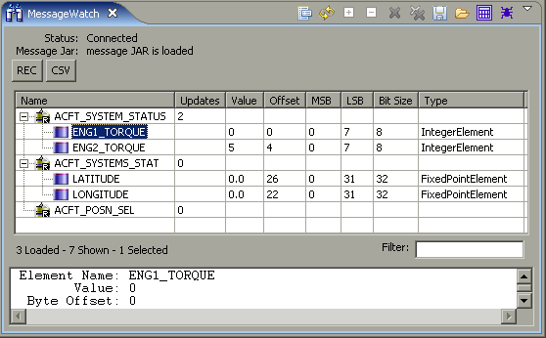
Messaging and Playback GUIs
Monitor, manipulate and record real-time messaging data
Advanced regular-expression searching for messages
Import/Export view lists
Playback environment
  Supports advanced debugging of the test environment using repeatable conditions
  Investigate real flight recordings

Slide 14
Questions?

Slide 15
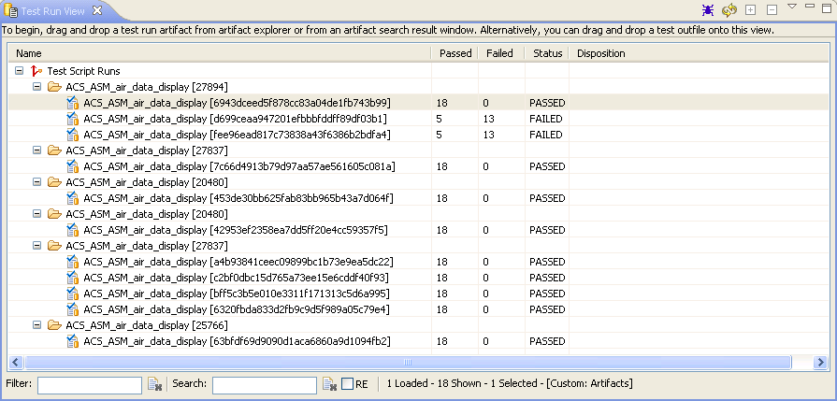
Test Run Results View

